Slide 1
Homework Setup

Slide 2
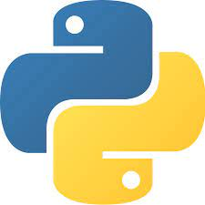
Description of the Homework
Welcome to Data Science Survival Skills. With this activity you will:
Install Anaconda (if not previously installed).
Learn how to set and use a virtual environment.

Slide 3



Anaconda
It is a Python distribution platform that allows us to install and manage Python libraries together with several Virtual Environments. Its installation comes with various packages and elements such as Jupyter Notebook, Spyder, Pycharm, and its GUI: Anaconda Navigator.
Notes:
Using the conda package manager

Slide 4
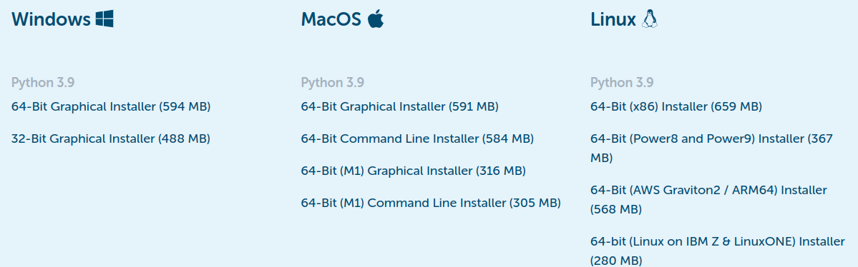
Prerequisites
To carry out this Homework, you need to install Anaconda. Its installation is straightforward, so you only have to follow the instructions of the official website: Link to Anaconda

Slide 5
1. Virtual Environment

Slide 6
Virtualenv
It allows us to have isolated the packages needed to work in a specific project; i.e., these packages don't affect the base Python installation. Using a virtual environment, you can use different versions of the same package for several programs without affecting each other.
Project 1
package==1.0
2.7
Project 2
package== 3.2
3.7

Slide 7
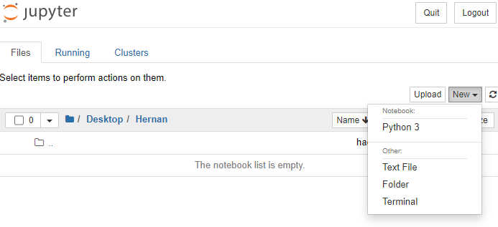
Jupyter Notebooks and venv
At this point, you should open Jupyter Notebook using Anaconda Navigator and select a web browser to run the notebooks. Subsequently, you will choose under "New" the option "Terminal."

Slide 8
Activating Venv
To create and activate your virtual environment we need to write the following on the command prompt:
conda create -n myvenv python=3.7
You will see the request “Proceed ([y]/n)?” from the command prompt. Press ‘y’ and then enter. This will create the virtual environment under the name “myvenv”. Finally, you can activate the venv by writing
conda activate myvenv
After the activation of the venv, you will see its name in front of the command line.
You can deactivate it using: conda deactivate

Slide 9
Using venv
Now we want to use this virtual environment within Jupyter Notebook. To do it, we can install and specify the kernel using the commands:
pip install --user ipykernel
ipython kernel install --user --name=myvenv

Slide 10
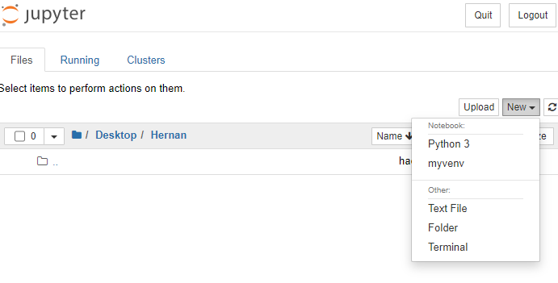
Using venv
If there are no errors, you can refresh the tab of the notebook and find the venv like:
This new file will be running using the virtual environment that we just created, and you can install the needed packages to use in your notebook.

Slide 11
And we are done!
Thank you

